Slide 1
Understanding Nightmares Impact on Anxiety
and its
Presented to: Miss Sehar

Slide 2
Presented By
Sarmad Irfan
Abeer Tahir
Ayka Imran
Eisha Naz
Fatima tuz Zahra
Ali Ahmad
Minahil Kamil
Syed Hadi Ali

Slide 3
Intro

Slide 4
Survey Method Overview
Definition:
A systematic approach to gathering data via questions targeting attitudes, actions, or knowledge.
When to Use:
Ideal for large sample sizes, trends, and patterns analysis.
Effective for standardized data collection and comparisons across groups.
Explores attitudes and opinions for deeper insights.

Slide 5
Key Steps in Survey Procedure:
Define study goals and objectives.
Design clear, concise, relevant questions.
Select representative samples (random, stratified, cluster sampling).
Choose survey mode: in-person, online, mail.
Analyze data with statistical methods to interpret findings.

Slide 6
Survey Details & Nightmare Study
Survey Features:
Method and Question Type :
Likert Scale: Attitude measurement (e.g., "Strongly Agree" to "Strongly Disagree")
Semantic Differential: Bipolar evaluation (e.g., good/bad)
Method: Online (Google Forms).
Question Type: Mix of closed-ended and open-ended
Purpose:
Study Highlights:
Examine psychological effects of nightmares.
Provide insights into mental health impacts.
Participants: 71 individuals (18+ years)
Focus: Frequency, intensity, and anxiety links in nightmares
Key Question: Do frequent nightmares correlate with higher anxiety?

Slide 7
Survey Strengths & Limitations
Context:
The online format ensured broad reach and quick data collection, though it carried a risk of self-selection bias due to voluntary participation. Open-ended questions were effective in capturing nuanced experiences, providing valuable insights.
Strengths:
Limitations:
Efficient for large-scale data collection
Standardized for consistency and comparability
Anonymity encourages honesty
Versatile for diverse topics
Bias Risks:
Self-report bias (inaccurate answers)
Non-response bias (low participation)
Limited depth for complex emotions
Question phrasing may influence responses

Slide 8
LITERATURE

Slide 9
Literature Review
Insights from books:
The Interpretation of Dreams by Sigmund Freud (1900) , He argues that nightmares are expressions of repressed fears and desires, disguised within symbolic imagery.
Men and His Symbols" by Carl Jung (1964) , views nightmares as subconscious signals to address neglected aspects of the psyche.
International Studies:
U.S. Study: "The Heritability of Nightmare Disorder , identified specific genetic markers that increase susceptible nightmares, paving the way for personalized treatments.

Slide 10
Literature Review
Pakistani Study:
Academic Stress and Nightmares Among University Students (2020), highlights the prevalence of anxiety-induced nightmares among students facing high academic pressure.
Insights from articles
A Longitudinal Study" (Sleep Medicine Reviews, 2015), examines how frequent nightmares can predict the onset of anxiety and depression.
The Genetic Basis of Nightmares" (Nature Communications, 2021), identifies genetic markers linked to nightmare susceptibility.

Slide 11
Causes and Common Interpretations
Psychological cause:
Stress& Anxiety, Trauma, Mental-health disorders
Physiological cause:
Medication, Substance Abuse, Neurological Conditions
Environmental Factors:
Sleep environment, Diet
Psychoanalytic and Cognitive Interpretations:
Sleep environment, Diet

Slide 12
Types of Nightmare:
Trauma-related
Recurring
Anxiety induced
Vivid dreams
Sleep Disorder-Associated Nightmares
Children and Adolescents
Trauma Survivors
Individuals with Mental Health Disorders
Those with Genetic Predispositions
Women
Who is Most at Risk?

Slide 13
Experiments on Nightmares
Lucid Dreaming as Treatment for Nightmares (Holzinger et al., 2020):
A study explored the use of lucid dreaming to help patients with PTSD reduce the frequency and intensity of trauma-related nightmares.
Imagery Rehearsal Therapy (IRT):
IRT helps people change their scary or distressing dreams into less upsetting ones.
Prazosin for PTSD Nightmares:
Help with nightmares by calming the body’s stress response during sleep.

Slide 14
METHODOLOGY

Slide 15
Survey Objective
Investigates Connection:
The survey investigates the connection between nightmares and anxiety.
Evaluates Nightmares:
It evaluates the frequency and intensity of nightmares experienced by individuals.
Analyzes Impacts:
Emotional and physical effects of nightmares are analyzed.
Goal:
The goal is to identify patterns and correlations for better understanding and managing anxiety-related sleep disturbances.

Slide 16
Problem Statement
Emotional Distress:
Nightmares are common but often cause emotional.
Underexplored Link:
The link between nightmares and anxiety remains underexplored..
Combined Impacts:
Combined impacts on mental health, daily life, and sleep quality are insufficiently studied.
Research Gap:
This research addresses the gap by analyzing participants’ experiences with nightmares.

Slide 17
Hypotheses
H1:
Frequent nightmares are associated with higher levels of anxiety.
H2:
Stress and anxiety increase the likelihood and intensity of nightmares.
H3:
The aftermath of nightmares correlates with anxiety symptom frequency.

Slide 18
Variables
Independent Variable:
Frequency and intensity of nightmares.
Dependent Variables:
Levels of anxiety, sleep quality, and daily functioning.
Controlled Variables:
Age, gender, and general health condition of participants.

Slide 19
Population
Target Population:
Adults aged 18 years and above form the target population.
Nightmare Experience:
Participants must have experienced at least one nightmare in the past year.
Diversity:
Individuals come from diverse cultural and social backgrounds.
Willingness:
Participation requires willingness to share personal experiences.

Slide 20
Sample
Recruitment:
The study recruited 71 participants, exceeding the required 50 minimum.
Age Group:
Most participants were within the 18-24 age group.
Demographics:
A significant portion of the sample comprised female participants.
Diversity:
The sample provides a diverse and representative group for the study

Slide 21
Sampling Technique
Method Used:
Convenience sampling.
Reason:
Practical and suitable for student-level research.
Boundary:
Responses gathered within the university setting.
Focus:
University students due to accessibility and alignment with BS-level scope and resources

Slide 22
Tool of Survey
Questionnaire:
Includes:
Structured, 25-item tool designed by the research team.
Demographics (e.g., age, gender).
Frequency and intensity of nightmares.
Emotional and physical impacts.
Perceived connection to anxiety.
Data Collected:
Format:
Both qualitative and quantitative.
Online, self-reported responses.
Purpose:
Covers all aspects of the relationship between nightmares and anxiety.

Slide 23
Source of Data
Primary Data:
Collected directly from participants.
Main Focus:
University students.
Reason:
Accessibility.
High likelihood of experiencing stress and anxiety (nightmare triggers).
Content:
Personal experiences with nightmares and anxiety.

Slide 24
Instrument of Study
Questionnaire:
Custom-designed to analyze nightmares and anxiety.
Purpose:
Thoroughly examines the connection between nightmares and anxiety.
Content:
Demographics.
Quantitative measures (frequency, intensity).
Qualitative insights (descriptions of nightmares, impacts).

Slide 25
Data Collection
Method:
Google Forms for accessibility and convenience.
Advantages:
Wide participant reach.
No physical distribution needed.
Confidentiality:
Responses anonymized.
Ensures privacy for sensitive topics.

Slide 26
DATA ANALYSIS

Slide 27
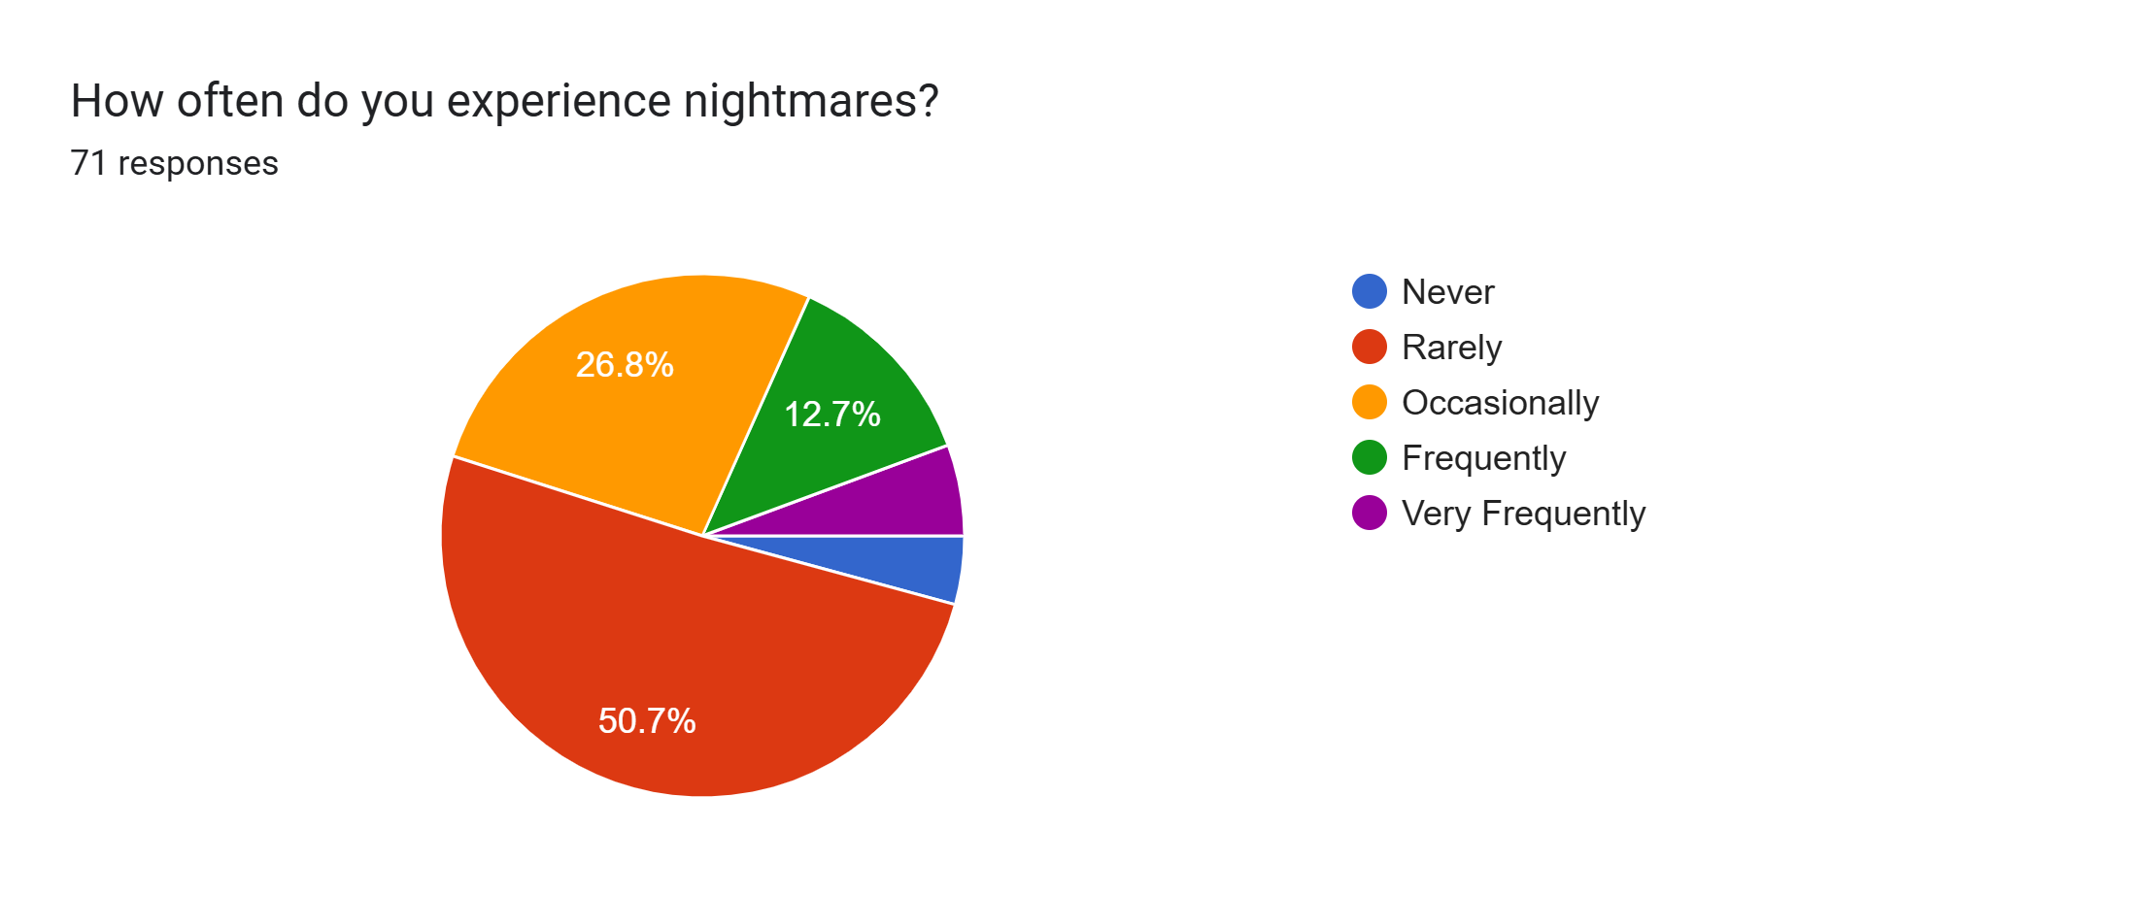
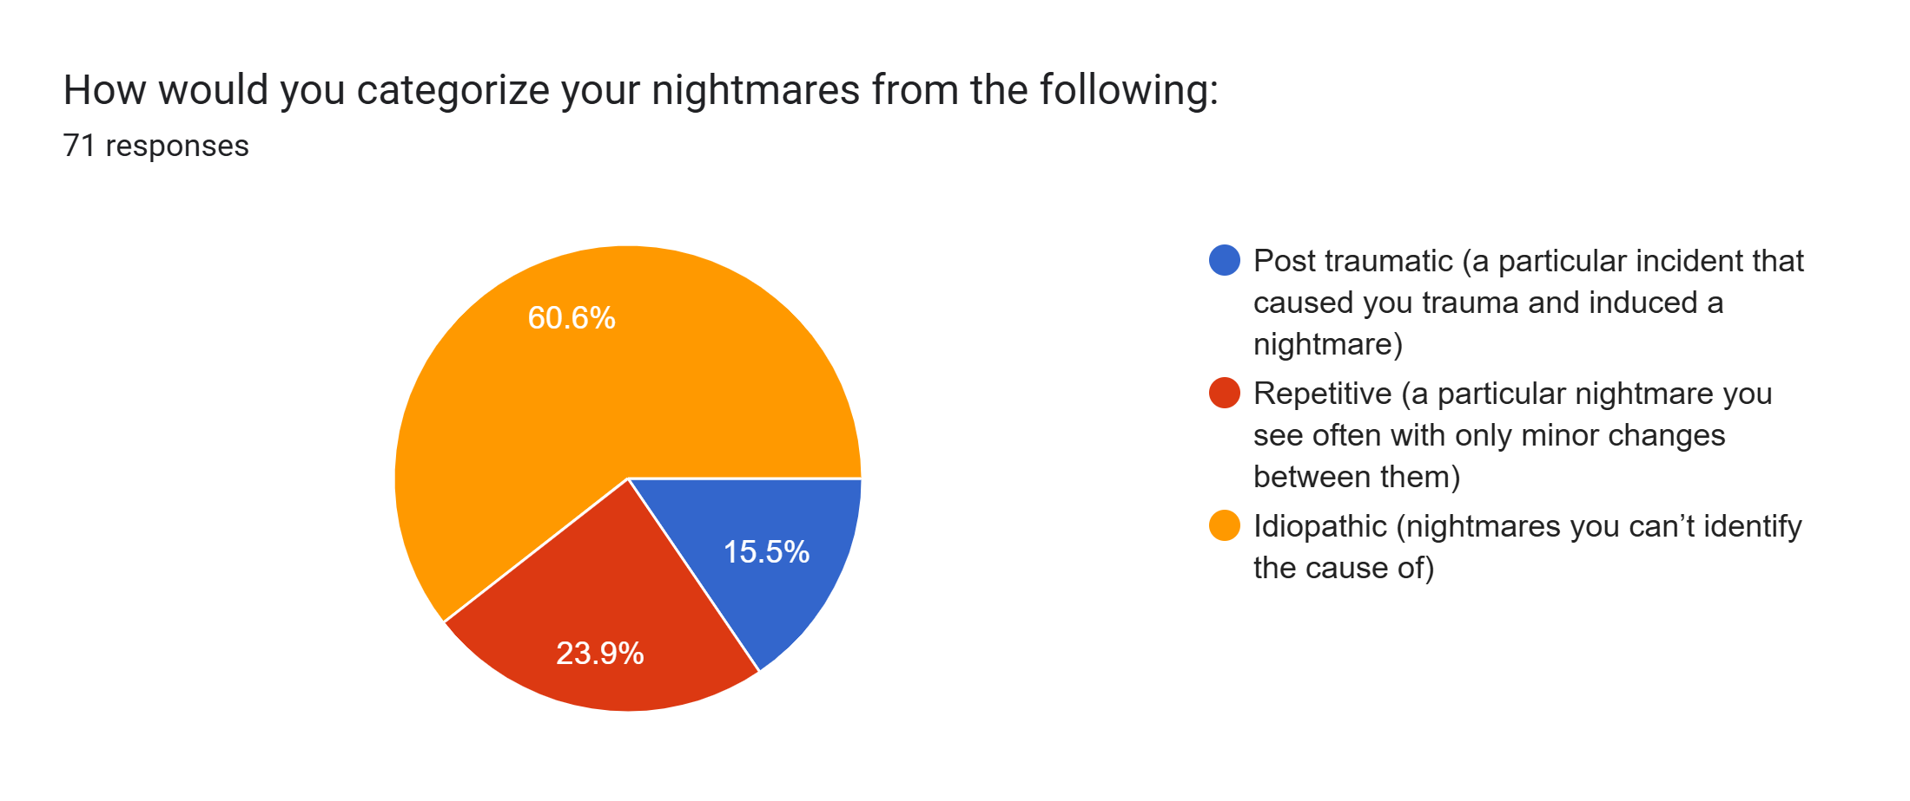
Prevalence of Nightmares:
Approximately 45% of respondents experience nightmares to varying degrees, ranging from occasional to very frequent occurrences.
While stress and trauma were identified as
triggers for some, 60.6% categorized there
nightmares as idiopathic
Although Many respondents demonstrated
awareness of the potential causes of there
nightmares suggesting a degree of
self-reflection or insight into their triggers.
This data also indicates a mix of underlying
factors beyond anxiety for the category of
idiopathic nightmares

Slide 28
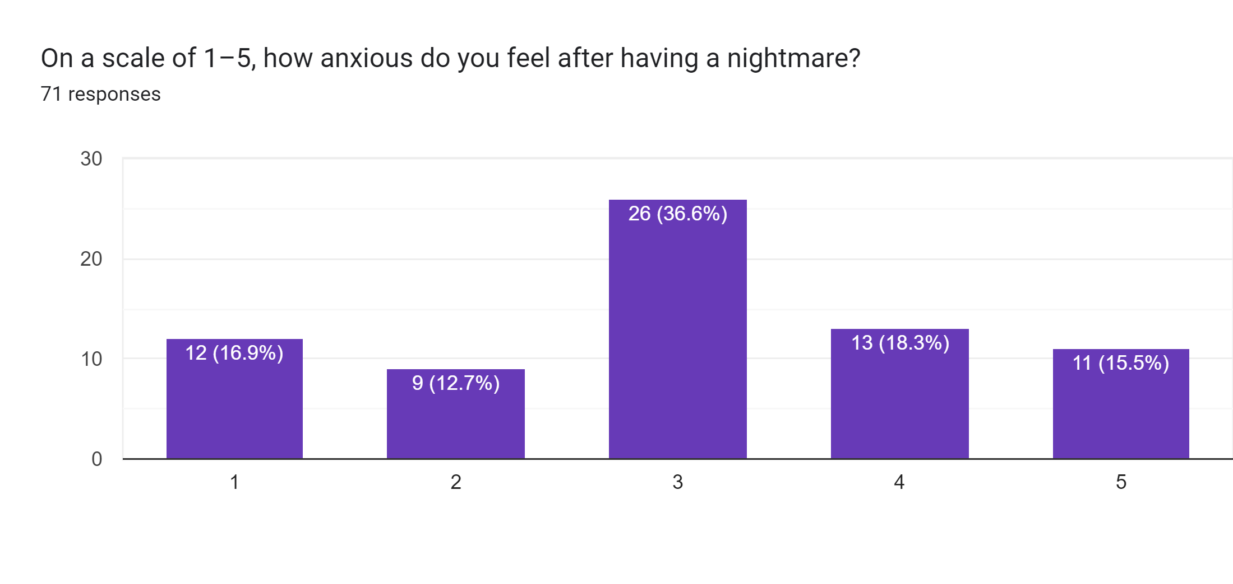
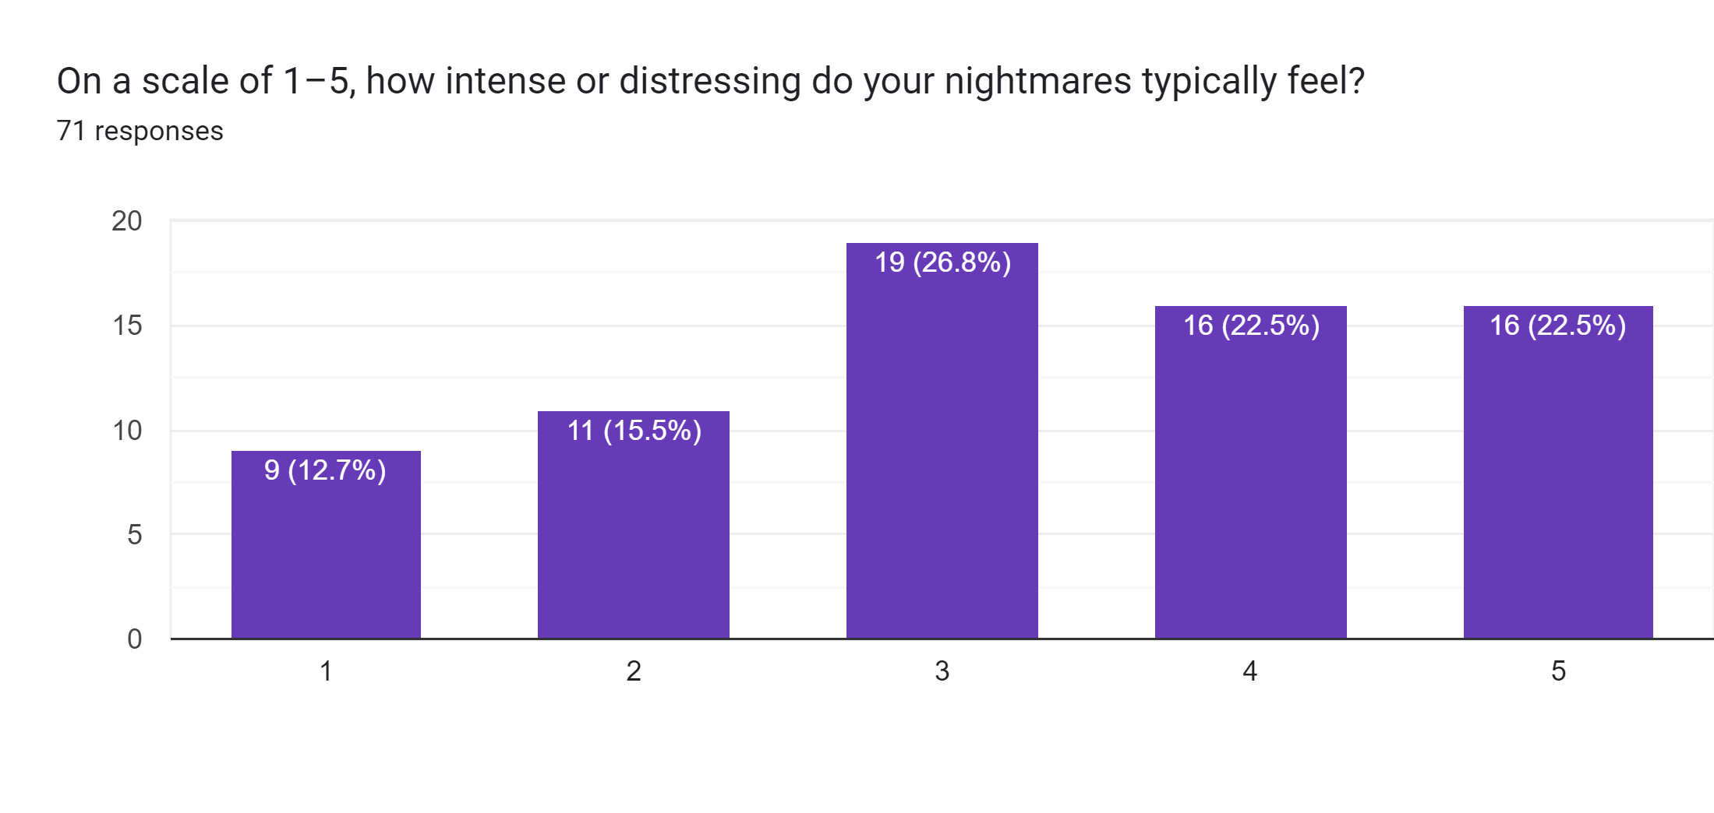
Anxiety Levels:
A significant proportion (45%) of respondents reported moderate levels of anxiety (score 3 on a 1-5 scale), indicating a connection between anxiety and nightmares.
The data indicates a significant relationship between frequent nightmares and heightened anxiety levels

Slide 29
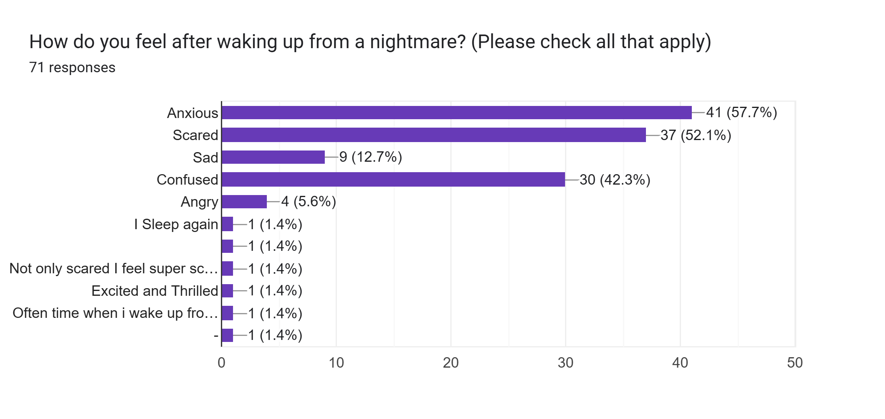
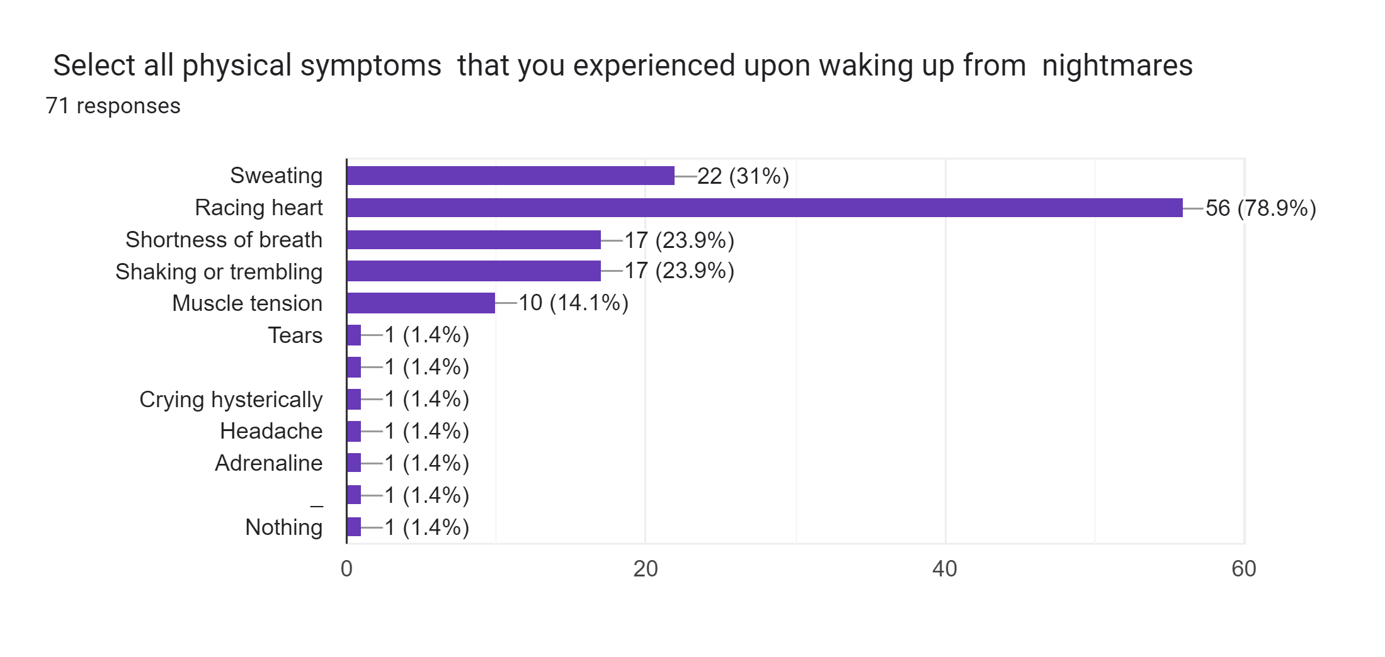
Physical symptoms such as sweating, heart racing, shortness of breath, shaking, trembling, and tension were commonly reported.
emotional symptoms such as fear, anxiety, sadness and confusion were prevalent.
Participants who reported experiencing frequent nightmares often described these intense physiological and psychological responses which align with symptoms of anxiety

Slide 30
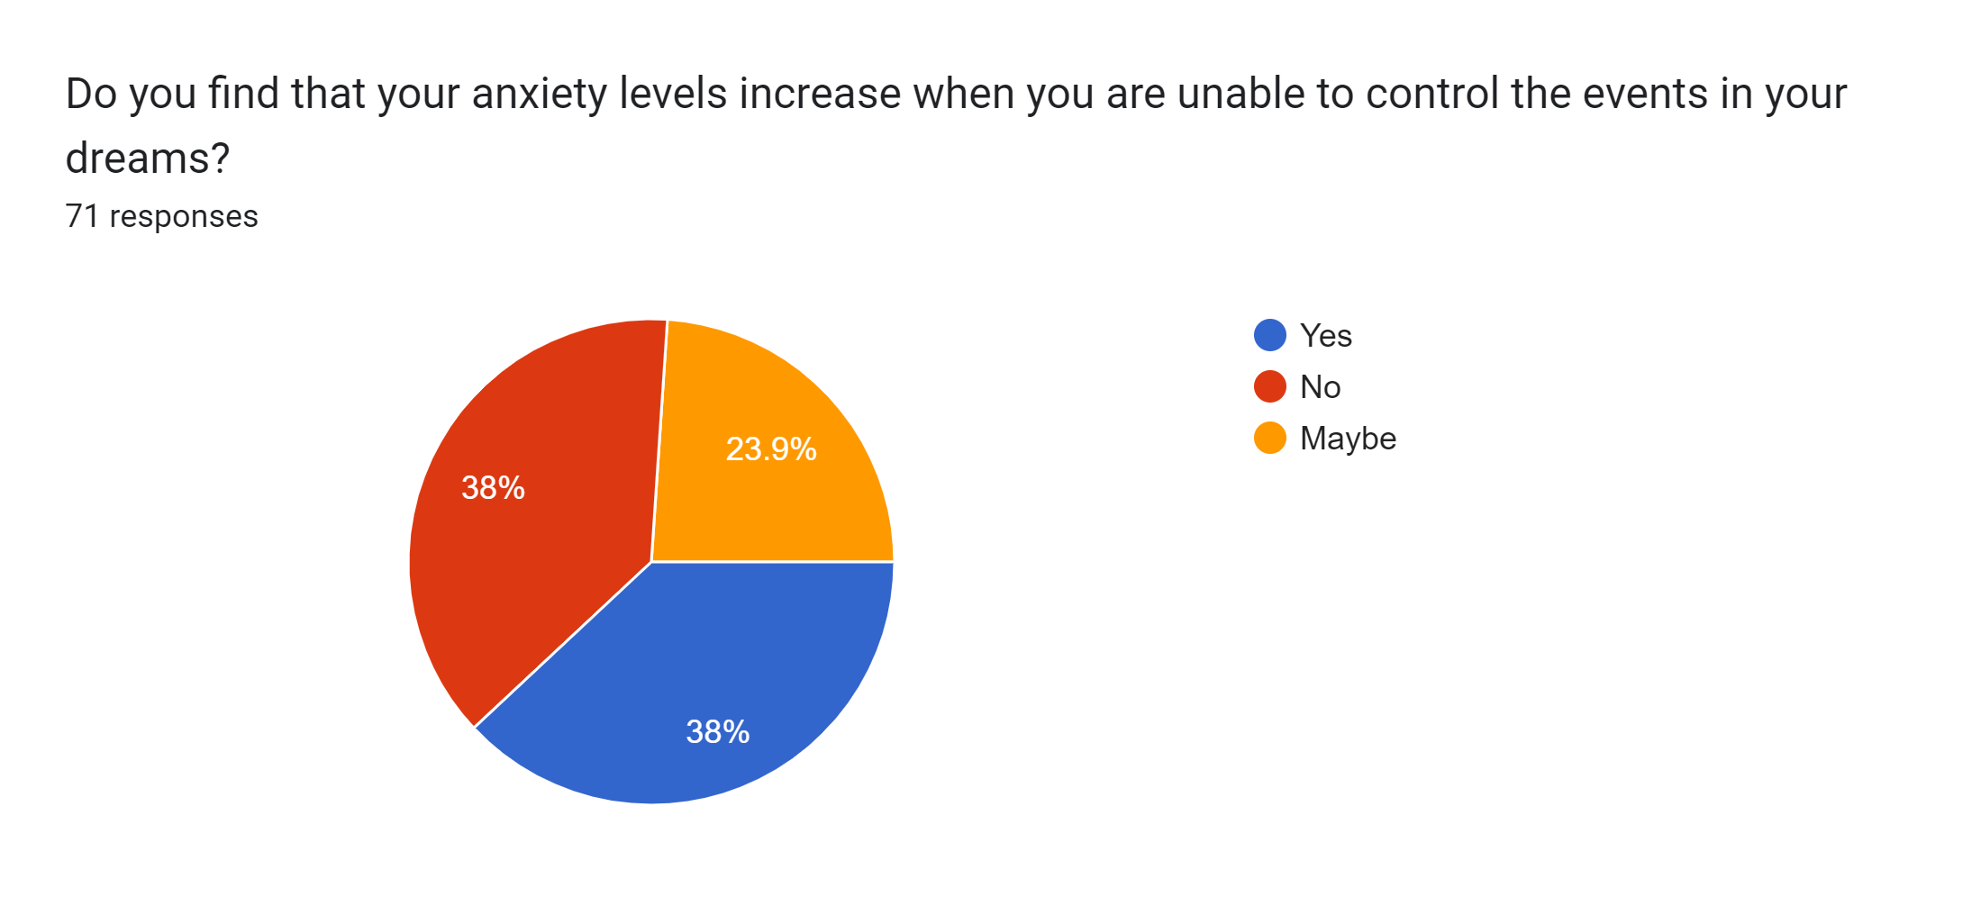
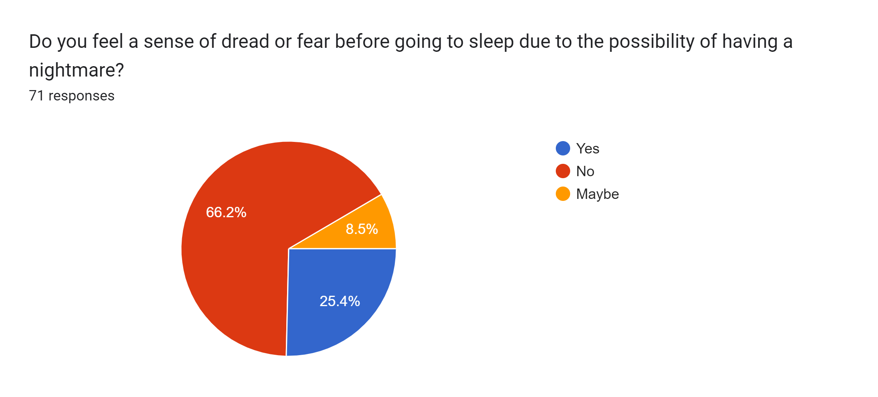
Sleep Disturbances: About 25% of participants dreaded falling asleep due to the potential recurrence of nightmares, significantly affecting their sleep quality.
Nightmares as Anxiety Amplifiers: The significant proportion (25%) of participants dreading sleep due to nightmares suggests that anxiety manifests strongly in their subconscious, creating a feedback loop where fear of sleep exacerbates anxiety and worsens overall mental health.

Slide 31
Control Over Dreams: Anxiety related to the lack of control in dreams was acknowledged by 38% of respondents, with an additional 28% recognizing this might be a concern.
Perceived Helplessness in Dreams: :
The high percentage (66% combined) concerned with control in dreams reflects a deeper sense of vulnerability and lack of agency, common traits in anxiety disorders, which may extend into their waking life, intensifying feelings of unease and helplessness.

Slide 32
Some further insights
57% of participants were able to proceed with their day as normal after a nightmare
The majority (70%) of participants reported no significant social or functional drawbacks from experiencing nightmares, highlighting individual differences in coping mechanisms.
The fact that 91.5% of participants had not sought professional help suggests potential barriers to seeking assistance or a lack of awareness about available resources indicating that other factors may influence the relationship.
Individuals who experience frequent nightmares often report symptoms consistent with higher anxiety levels

Slide 33
Conclusion
The findings partially support the hypothesis, but variability in responses and other influencing factors call for more controlled studies to establish a definitive connection between frequent nightmares and anxiety.
The research highlighted critical trends and patterns that aligned with the research objectives.
The study has demonstrated the importance of addressing the research problem through evidence-based practices.
The alignment of findings with previous research strengthens the study's reliability, while deviations highlight areas for further exploration.

Slide 34
Thanks!

